Slide 1
Enhancement Due to Photonic Coupling in Nanocavity Structures
Bumbia, Amal;
Abudayyeh, Hamza;
Liu, Zhida;
Li, Xiaoqin
Department of Physics UT Austin

Slide 2
Background

Slide 3
How do quantum emitters work?
Optical properties!
Spontaneous photon emission!
2-level Quantum emitter
Electromagnetic environment
How can we alter this environment to favorably influence the decay rate of the system?
Multiple 2-level systems with differing polarization or wavelength
Notes:
Quantum emitters possess optical properties that are a result of an interplay between the energy levels of the emitter and its electromagnetic environment. Given a 2-level system, you can modify its decay rate by altering the environment.
Quenching occurs when the emitter is too close to the metal so no photons within < 4 nm from the metal surface are emitted. Thus, there is no optical coupling. This is a loss mechanism.

Slide 4
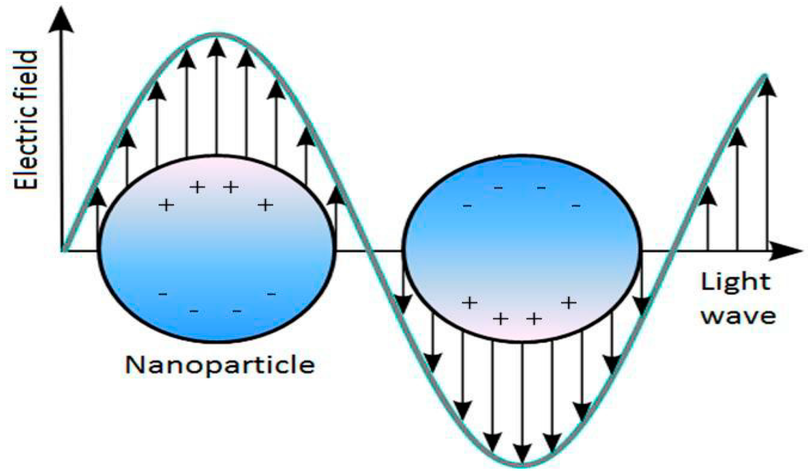
Why can a nanoscale emitter can have emitting behavior?
e-
Plasmon - EM field via the collective oscillations of material’s conduction electrons
Exciton - electron-hole pair
interaction between the excitons of the emitter and the plasmons of the nanoparticles — emitter is one of the excitonic transitions
Notes:
collective excitation of electrons the electromagnetic field produced by the collective oscillations of the conduction electrons in a given material

Slide 5
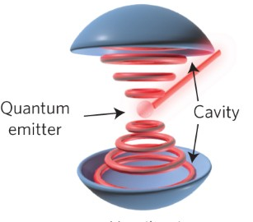
What is the interplay between quantum emitters and cavities?
enhanced photon emissions into free space
coupled resonantly
exchange photons
contains plasmonic resonances
emits into the plasmonic cavity
focuses the emission fields into a mode volume
Notes:
A plasmon refers to a partially optical and partially electronic excitation. Plasmonic cavity has different modes; looks different than this

Slide 6
Cavities can impact emitters in a few ways:
decay rate enhancement --- weak coupling of a 2-level emitter to a cavity -> modification of the spontaneous emission rate so emitter can have multiple radiative modes and some nonradiative processes
emission redirection --- intrinsic radiation pattern of a quantum emitter is omnidirectional, making it hard to collect emitted photons. Cavities can redirect the emission to the desired optical mode with an efficiency ξ. Different modes can have different efficiencies.
absorption enhancement --- cavities alter the absorption cross-section of the emitter causing absorption enhancement and lowering saturation power needed from the pump laser

Slide 7
Coupling parameters:
emitter's decay in free space Γ0
cavity's loss rate κ
emitter-cavity coupling coefficient g
Parameters depend on the overlap of the photonic cavity and the resonances of the 2-level system.
Due to the interplay between the photonic cavity and the system, we are able to enhance some processes at the expense of others.
For instance, if the resonances of the plasmonic cavity are vertical, they selectively enhance dipole emitters with a vertical dipole.
Not only are we increasing the lifetime, but we are also altering our characterization and probability of the emission.
What matters is coherence and its impact on the photonic field. We aim to enhance all photons in the emission.
Notes:
What matters is coherence and its impact on the photonic field. We aim to enhance all photons in the emission.
A process will impact a lower-probability event more than one with a higher probability since quantum efficiency has a lesser chance of being improved in the latter.

Slide 8
Weak Coupling Regime
We are concerned with the weak coupling regime g < κ, Γ0.
Here, the photon is released by an excited emitter due to spontaneous emission and lost to far-field radiation modes leaving the cavity in a vacuum state.
In this case, the cavity becomes the system's environment and results in a modified decay rate Γ = F Γ0 where F = 3/(4π^2) Q (λ^3)/V (Purcell factor - represents the shortening of lifetimes; losses ensure that it is not directly related to the number of emitted photons), Q ~ 1/κ (cavity quality factor), and the cavity mode volume V/λ^3.
The advantage of the weak coupling regime is that for emitted photons, the probability that they will be reabsorbed by the emitter is low compared to the likelihood of the photon escaping the cavity.

Slide 9
What are the effects of weak coupling between plasmonic nanocavities and excitons?

Slide 10
How does plasmon-exciton coupling effect emission enhancement?

Slide 11
Background
Sample 1 : Gold Nanocube

Slide 12
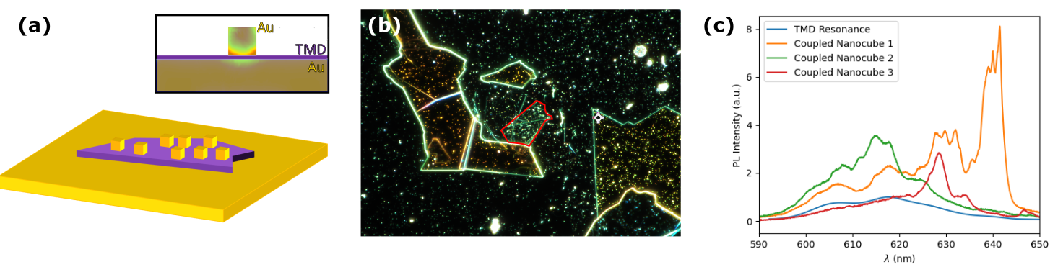
Sample 1: Gold Nanocube : Optical Data
Material: Monolayer TMD
Film-Cube Separation: 8-9 nm
The lightning-rod effect (EM fields concentrating) causes the corners of the cubes to be the regions of greatest enhancement
cavity
nanocubes
(70-100 nm)
TMD
gold foil
Notes:
Simulation of single nanoresonance of one cube and colors are intensity of the field, increase of intensity in the corners of cube, lightning rod effect — one reason why nanocubes work how they do
A reason why nanocubes enable photonic enhancement is because the electromagnetic field is more intense at the corners of the cube - the lightning-rod effect. Nanocube size and film-cube separation impact where plasmonic resonances occur.
The excitons of the emitter and plasmons of the nanocubes couple in a plasmonic cavity which focuses the emission fields into a mode volume. The mode volume impacts the probability of the field interacting with the emitter. A higher probability in this regard increases the probability of spontaneous emission and decreases the lifetime. The photons emit from the cavity and into free space, enhanced due to the weak coupling mechanism.

Slide 13
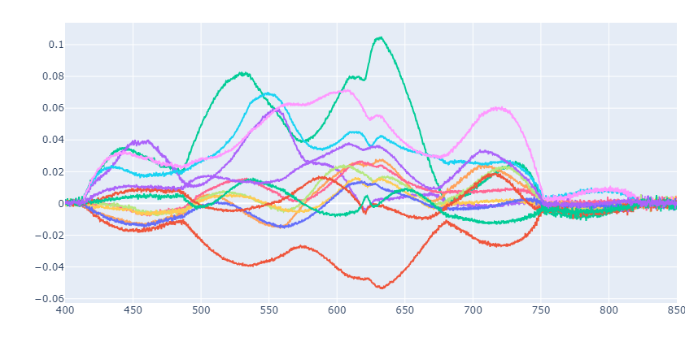
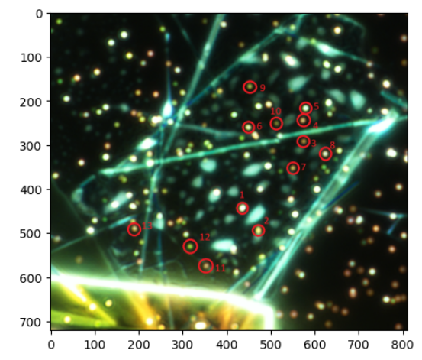
Dark Field Spectroscopy
Where do the plasmonic resonances occur?
This is a point where the data gets murky…
540 nm
625 nm !!!
725 nm
white light scattering by nanocavities
measure plasmonic resonances

Slide 14
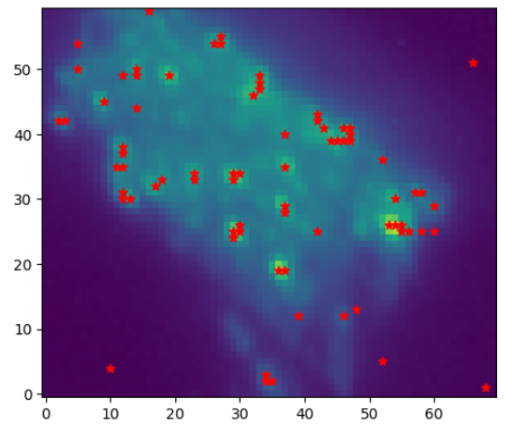
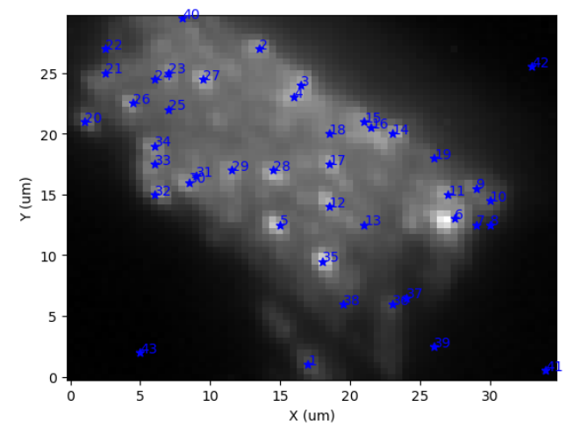
Hyperspectral Spatial Image
well localized points with nanocubes
intensity coming out of these points is enhanced

Slide 15
Photoluminescence (PL)
excite sample at different wavelengths
measure exciton resonances
longer wavelengths enhanced
greater, non-uniform intensity enhancement along nanocubes
find overlap between the wavelengths where plasmonic resonances and enhancement occur
Enhanced exciton emissions!
Notes:
Overlap between the plasmonic resonances and exciton excitation
provides evidence for the coupling as it facilitates enhancement. Longer wavelengths are enhanced, and there is greater, non-uniform intensity enhancement along the nanocubes. Differently sized cubes enhance different parts of exciton spectrum. We see that the enhanced resonances have the same polarizations and spectral resonances as the plasmonic resonances.

Slide 16
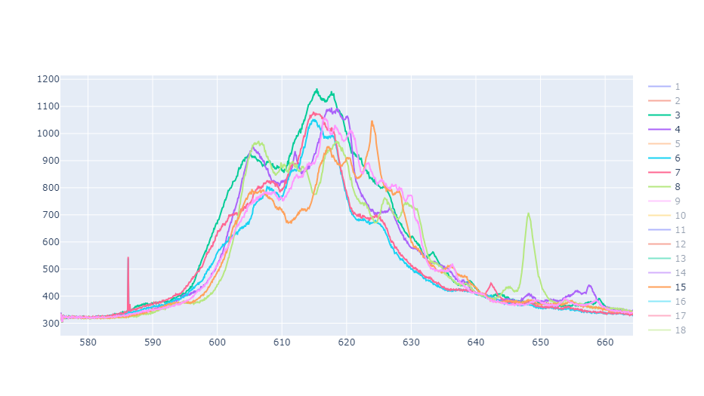
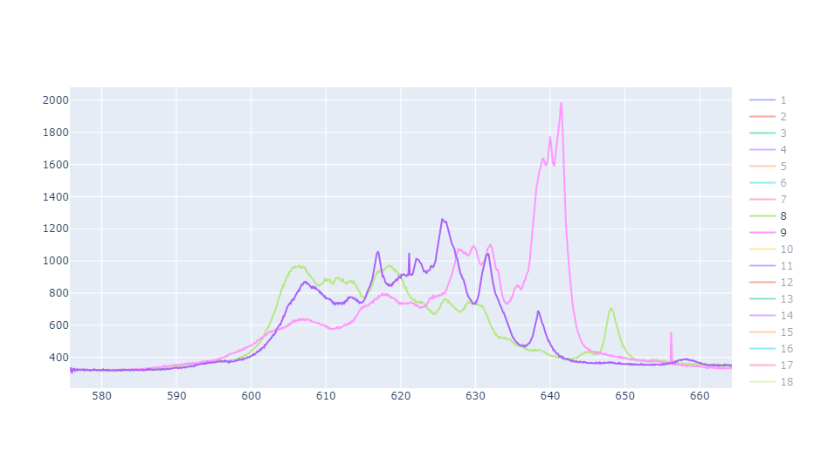
Notice the peaks between 603-609 nm and 612-620 nm and around 625 nm
Sight trough at 608-611 nm and again at 620-625 nm
These were the brightest spots - less uniformity between them but we still have peaks at around 605, 630 , 640 and 615 nm
Recall the plasmonic spectrum via dark field spectroscopy and the peaks around 625 nm — possible overlap between plasmonic and exciton resonances?

Slide 17
Background
Sample 1 : Gold Nanocube
Sample 1 : Silver Nanocube

Slide 18
Sample 1: Silver Nanocube : Optical Data
Material: Monolayer TMD
Film-Cube Separation: 8-9 nm
Initially, the silver nanocubes were placed onto the original gold nanocube sample. There was an issue with the trilayer sample so it needs to be remade.
cavity
nanocubes
(70-100 nm)
\ Ag
TMD
gold foil
Notes:
Simulation of single nanoresonance of one cube and colors are intensity of the field, increase of intensity in the corners of cube, lightning rod effect — one reason why nanocubes work how they do
A reason why nanocubes enable photonic enhancement is because the electromagnetic field is more intense at the corners of the cube - the lightning-rod effect. Nanocube size and film-cube separation impact where plasmonic resonances occur.
The excitons of the emitter and plasmons of the nanocubes couple in a plasmonic cavity which focuses the emission fields into a mode volume. The mode volume impacts the probability of the field interacting with the emitter. A higher probability in this regard increases the probability of spontaneous emission and decreases the lifetime. The photons emit from the cavity and into free space, enhanced due to the weak coupling mechanism.

Slide 19
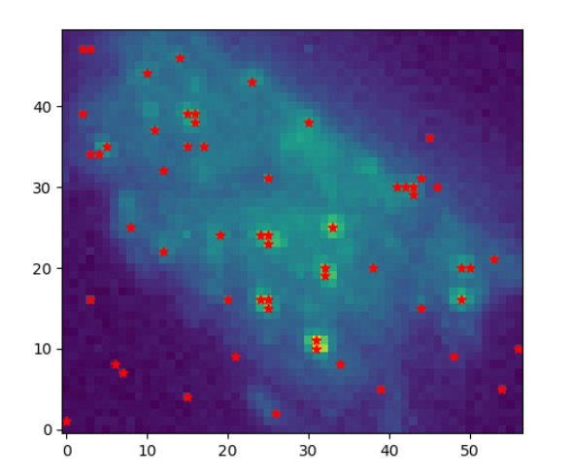
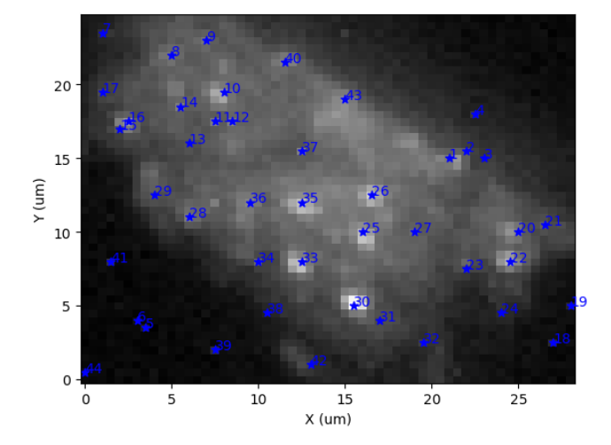
Hyperspectral Spatial Image - Cryogenic

Slide 20
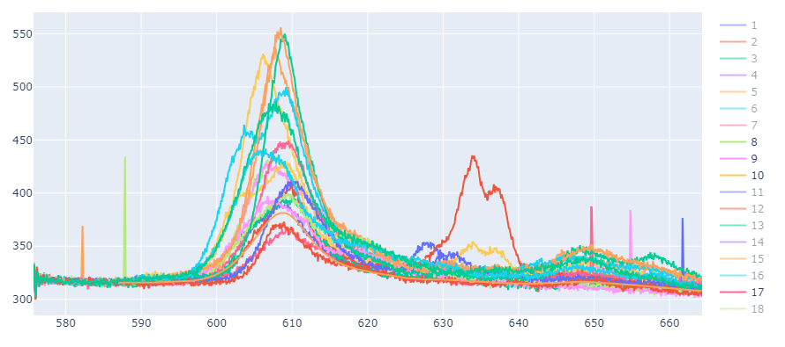
Cryogenic Spectra - cleaned

Slide 21
Do the spectra of the same points peak at the same wavelengths between the samples? How does the presence of silver nanocubes impact the measurements?
Can we identify which points are likely silver nanocubes?
In general, how do the peaks differ between the gold and silver nanocubes? Does either provide more obvious enhancement?
Comparing Cryogenic Results

Slide 22

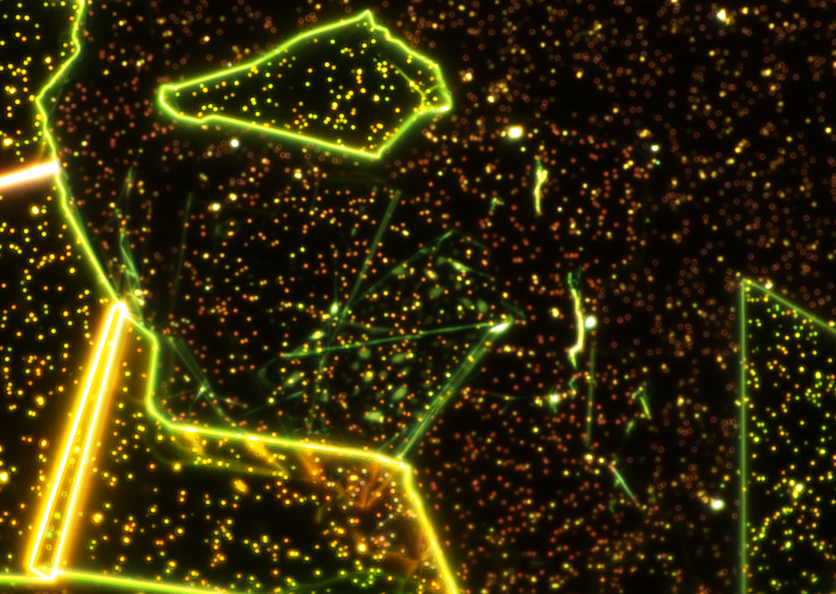
Sample 1 Before and After Silver Nanocube Placement

Slide 23
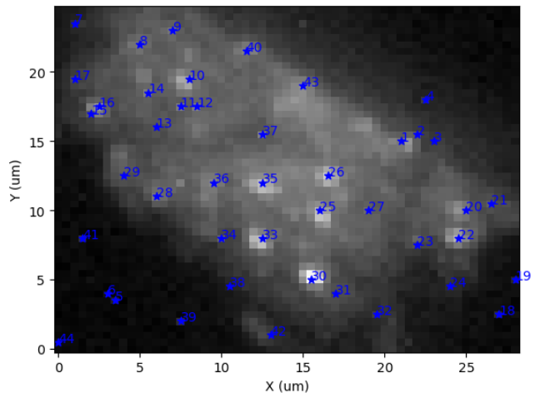
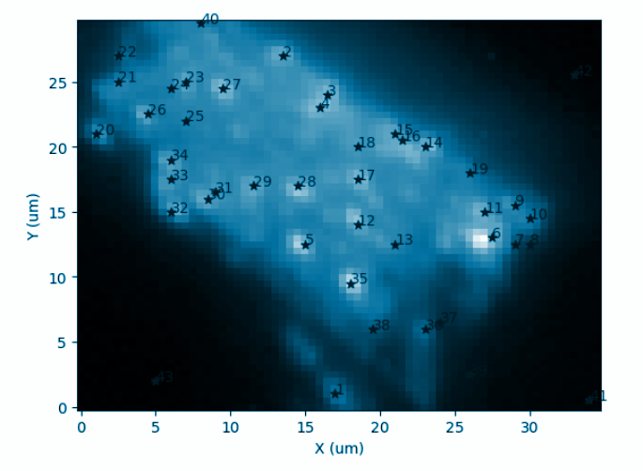
Grey points - Cryo Au
Blue points - Cryo Ag
Ag — Au
8 - new silver
9 - 40
10 - 27
13 - 25
17 - 21
20 - 11
21 - 9
22 - 6
23 - new silver
25 - 12
26 - 17
27 - new silver
29 - 33
31 - new silver
33 - 5
35 - 28
36 - 29
42 - new silver
43 - 3

Slide 24
Can we identify which points are likely silver nanocubes?
Yes!

Slide 25
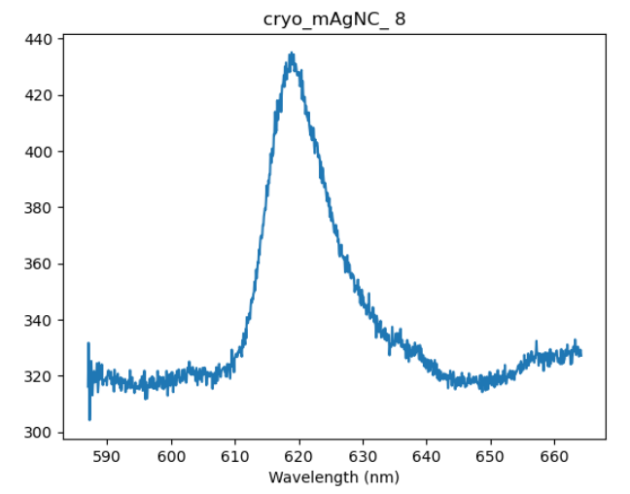
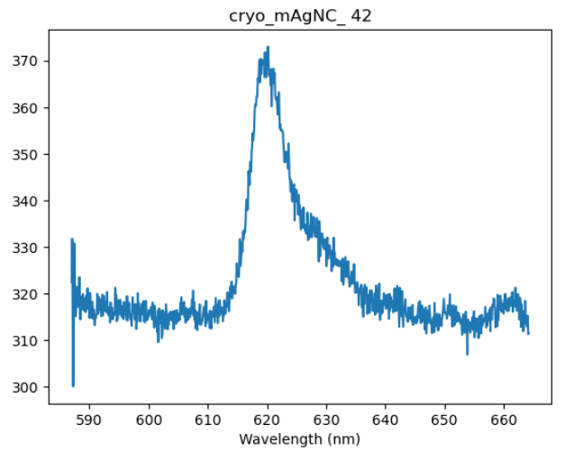
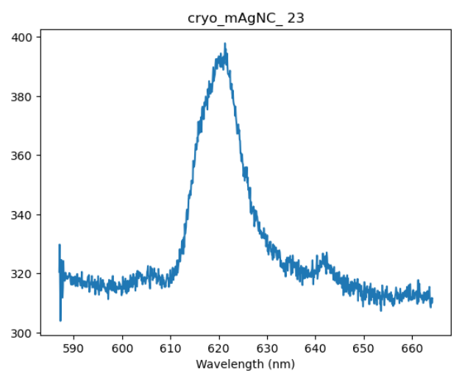
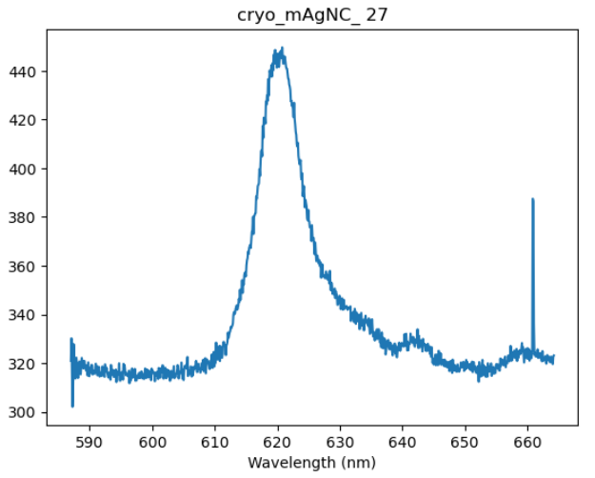
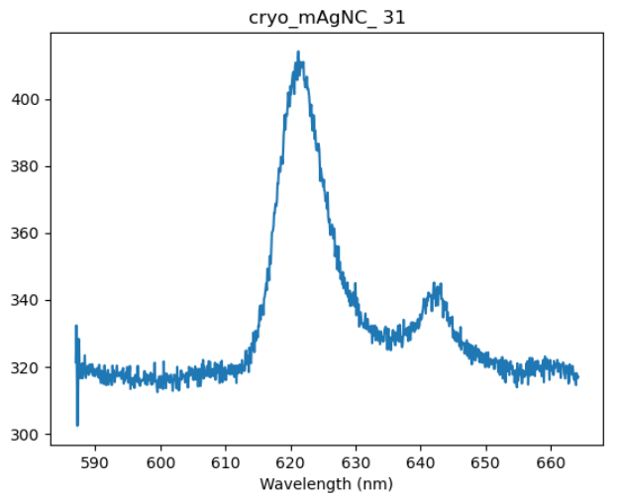
Likely silver nanocubes — notice peaks around 620 nm and similar spectra

Slide 26
Group 1
The following points are interesting because they resemble the silver nanocube spectra but are correlated with gold nanocubes

Slide 27
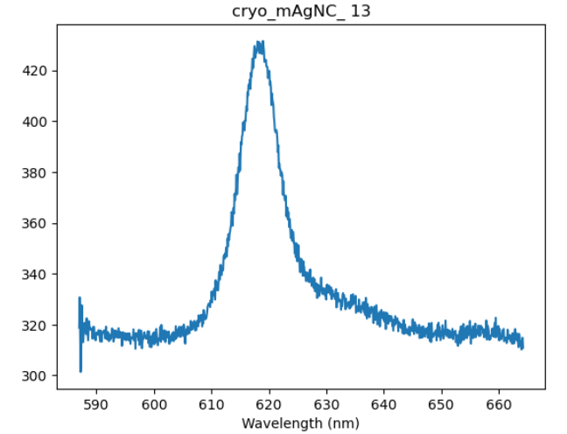
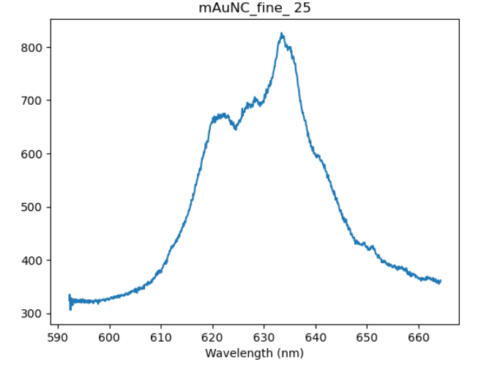
Notes:
Convolution of

Slide 28
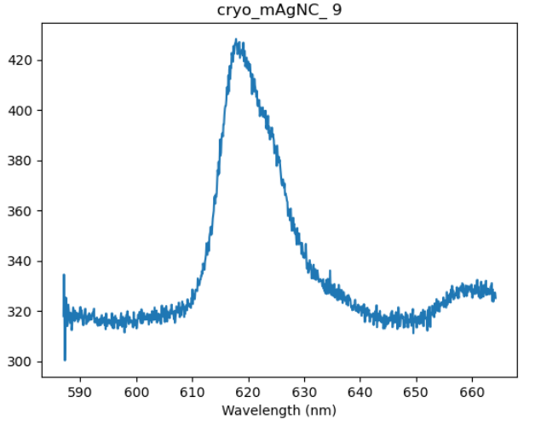
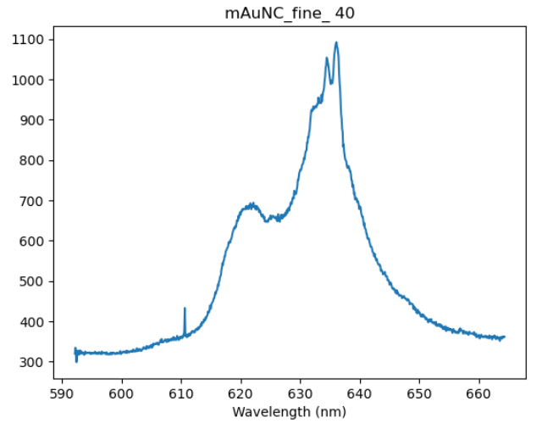

Slide 29
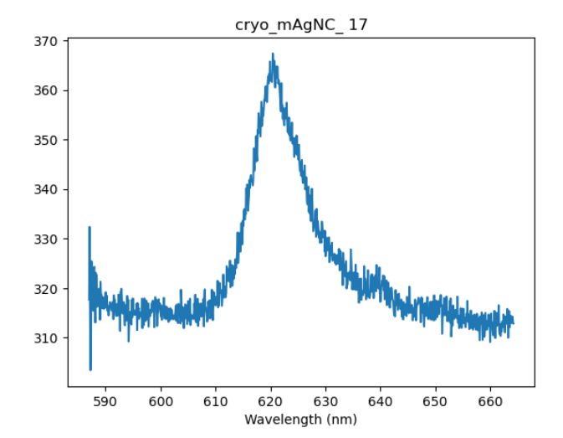
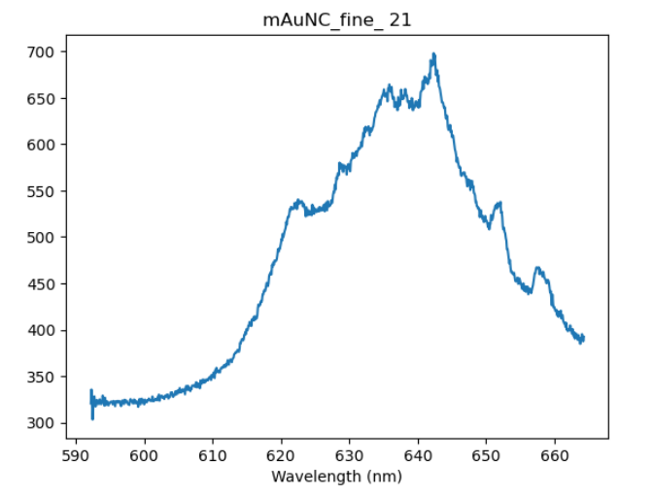

Slide 30
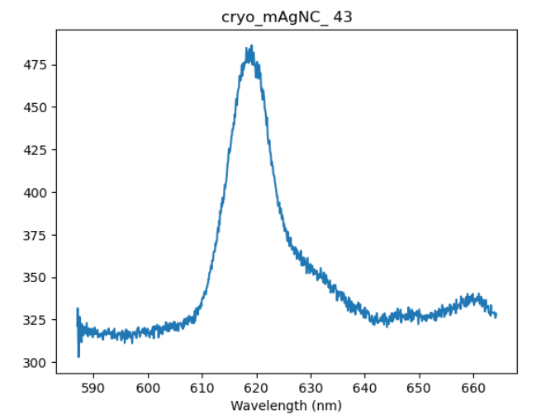
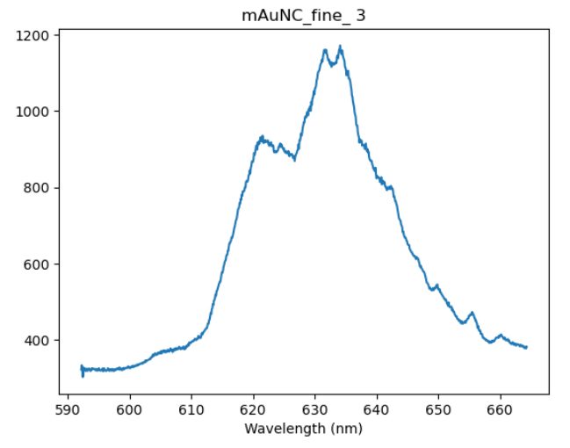

Slide 31
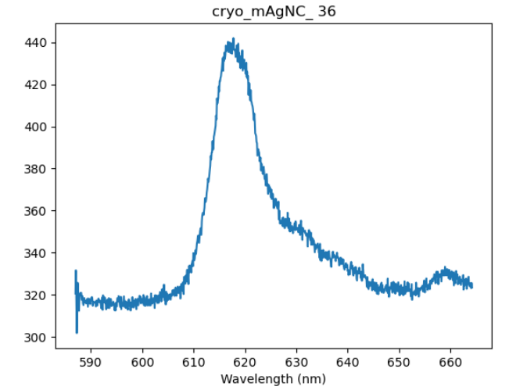
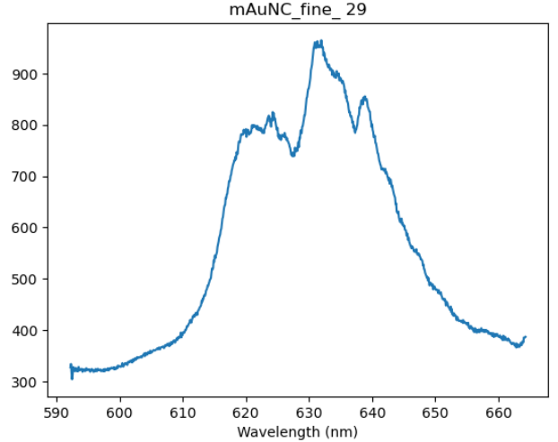

Slide 32
Group 2

Slide 33
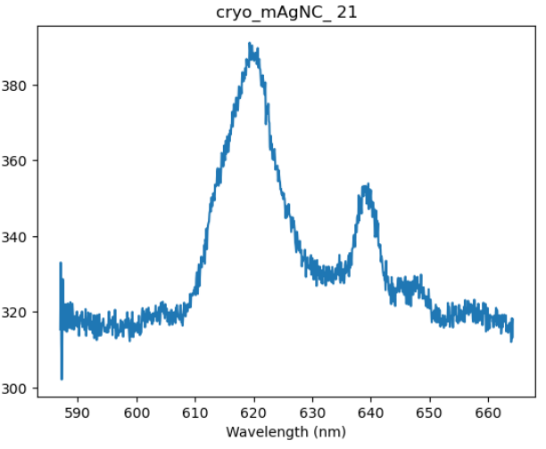
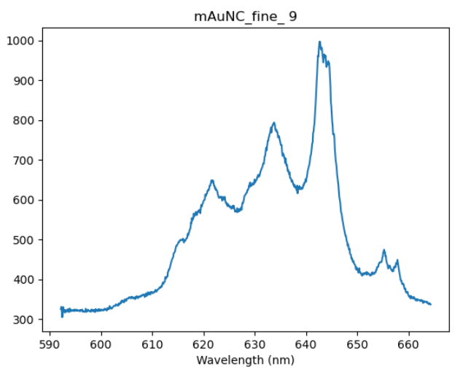

Slide 34
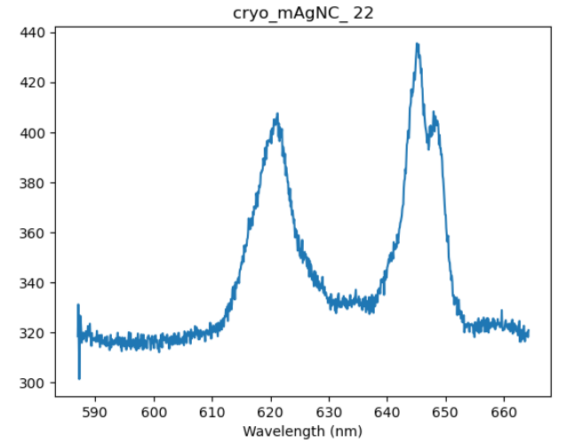
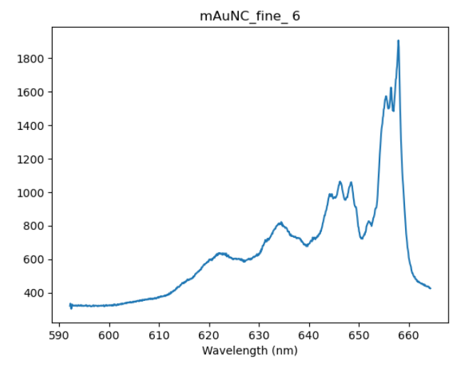

Slide 35
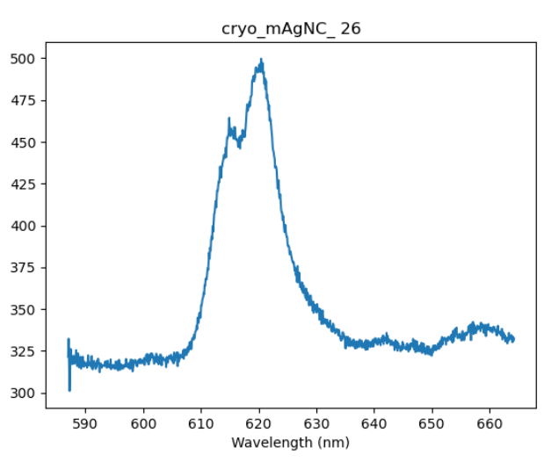
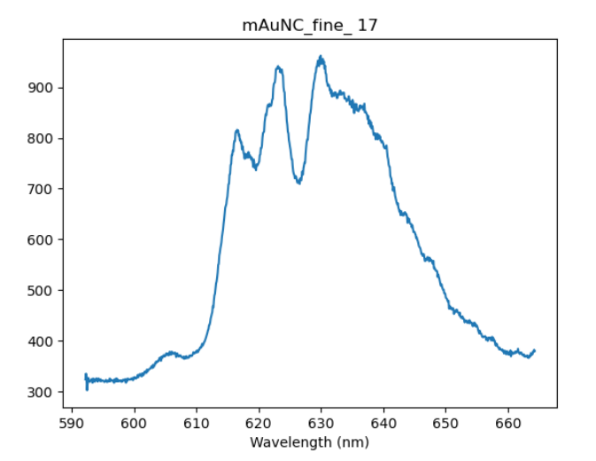
Definitely a gold nanocube point!

Slide 36
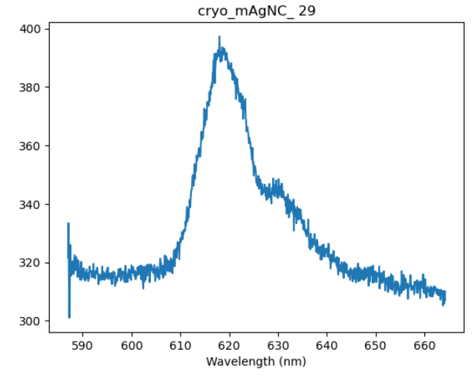
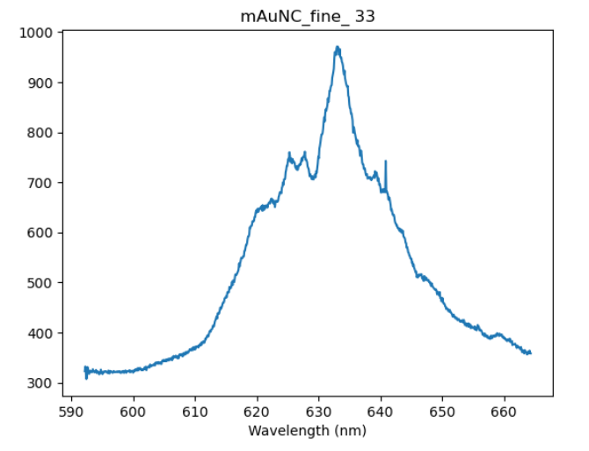

Slide 37
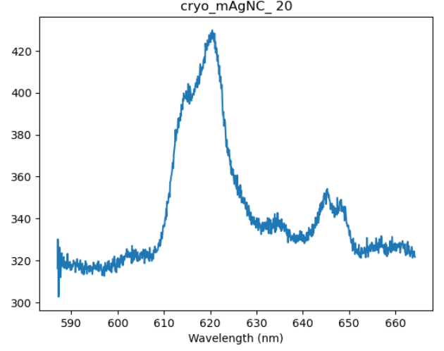
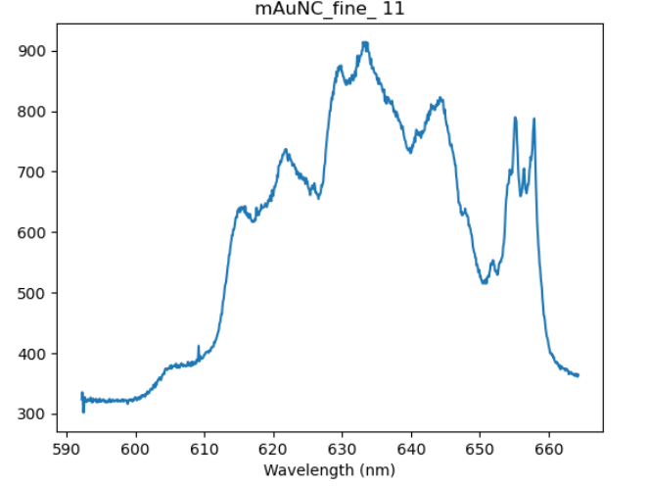

Slide 38
Group 3

Slide 39
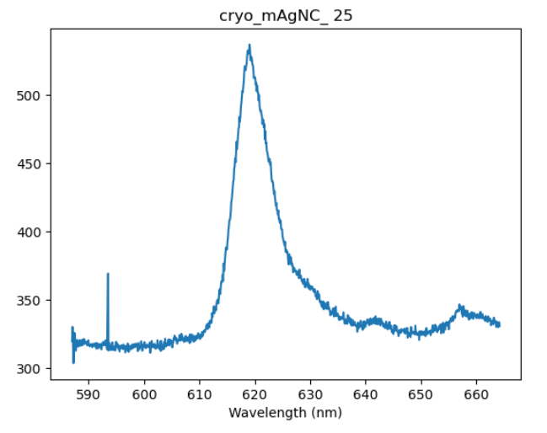
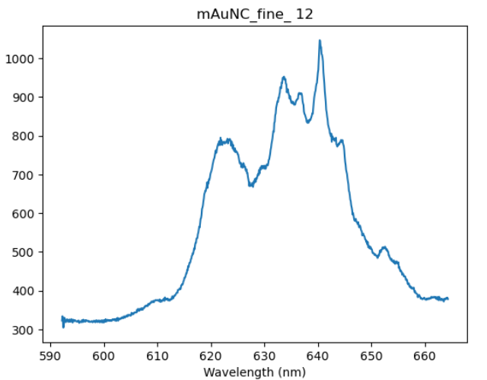

Slide 40
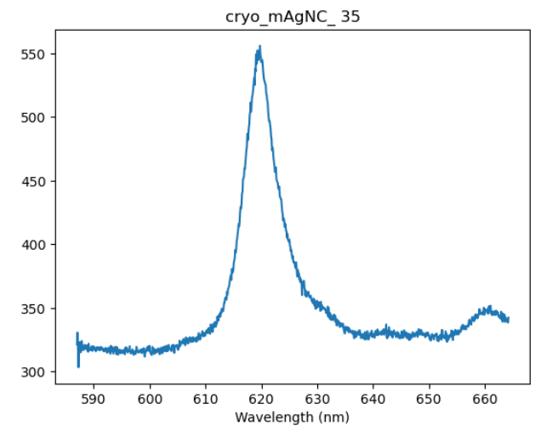
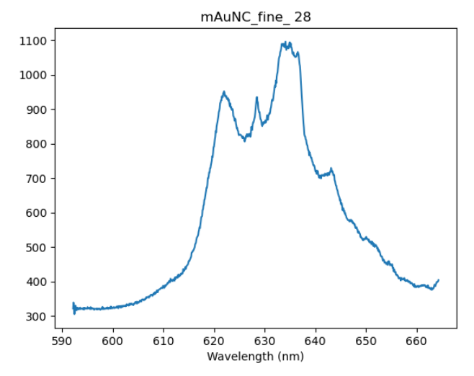

Slide 41
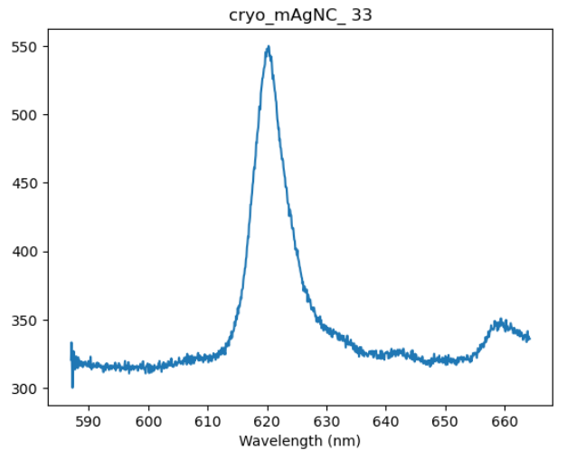
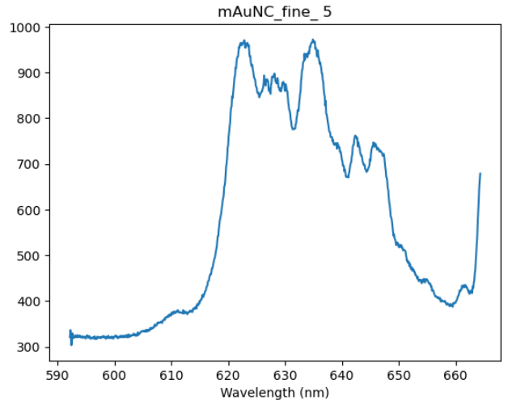

Slide 42
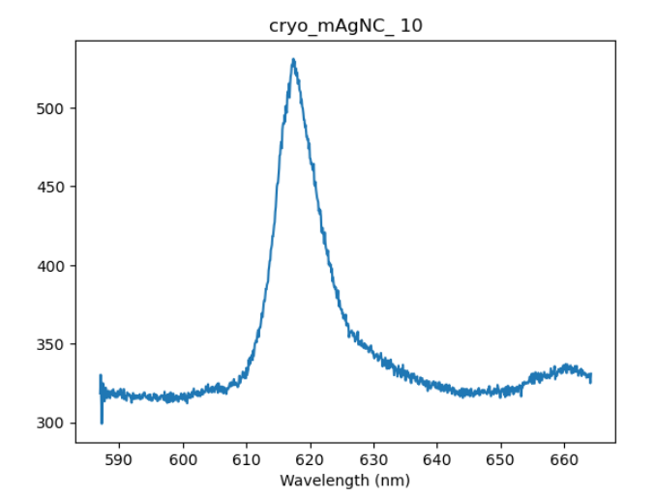
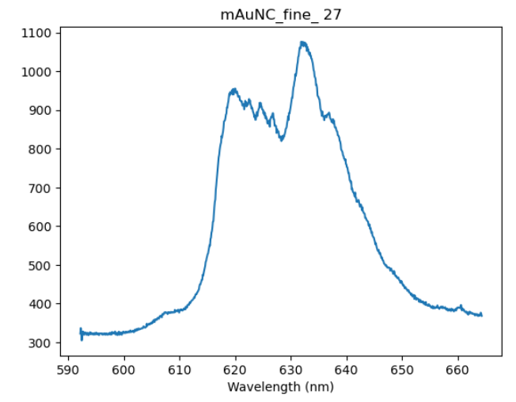

Slide 43
Do the spectra of the same points peak at the same wavelengths between the samples? How does the presence of silver nanocubes impact the measurements?
It seems like some peaks existed in both measurements between the same gold nanocube points. There may be some odd interactions between the gold and silver cubes.
Notes:
Recall from before the darkfield spectra measuring the plasmonic resonances of the gold nanocubes? There was a point to note — the peaks around the 620-625 nm mark. In the gold nanocube sample neglecting the presence of silver cubes, the intensity did peak in that range. So did the intensity including silver cubes and that of the silver cubes. This correlation would be more clear if we had darkfield spectra data from the silver cube sample.

Slide 44
In general, how do the peaks differ between the gold and silver nanocubes? Does either provide more obvious enhancement?
The gold nanocubes without any influence from the silver caused the highest peaks in the spectrum to be in the 615-620 nm range.
Overall, it appears the silver candidates have cleaner spectra and more obvious peaks than the gold nanocubes did. With the current data, there’s no discernable difference in whether or not there’s more obvious enhancement between the silver and gold nanocubes.

Slide 46
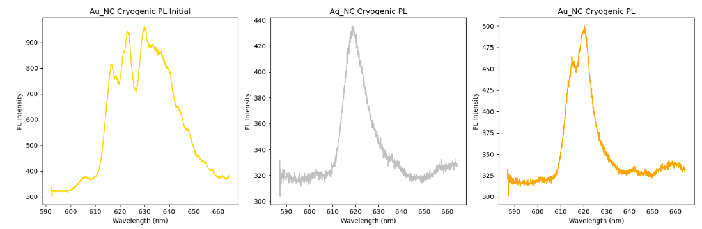

Slide 47
